Slide 1
A unifying software framework for vehicle routing and logistics.
Jannik Enenkel , Jannik Geyer , Jan-Niklas Keiner , Johannes Nguyen,
Jan Steuler and Neil Urquhart
Edinburgh Napier University
School Of Computing
10 Colinton Road
Edinburgh, UK

Slide 2
Motivation
Involved in a number of research and commercial projects
Routing urban milk deliveries
Scheduling social care workers
Routing food deliveries
Multi-objective routing
Modelling and optimising commuters

Slide 3
Motivation
What do all of these have in common?
They all need to access real-world data
The problem:
Differing data sources are accessed in different ways
Online APIs
Localised data
Differing providers produce differing formats of answer
Moving applications between data providers becomes difficult

Slide 4
An example
A research study (Judson, Hart & Urquhart) looked at optimising social care visits
Workers could travel by public transport or by car
Two scenarios were looked at, the City of Edinburgh and the City of London
The data sources that we had to work with were
The Transport for London API for London area p

Slide 5
An example: 2
The data sources that we had to work with were
The Transport for London API
The Travel Line Scotland Journey Planner
Open Streetmap / GraphHopper

Slide 6
An example: 3
Although the algorithm (NSGA-II) is the same for all of the examples an extensive amount of modifications had be to be carried out to allow all three data sources to be integrated.

Slide 7
Outline Concept
Can we produce a framework that makes it simple to work with multiple sources of Geospatial information?
Base the framework on design patterns such Façade and Factory to hide the detail.
The application programmer can concentrate on writing the application and not worry about the nature of the data sources

Slide 8
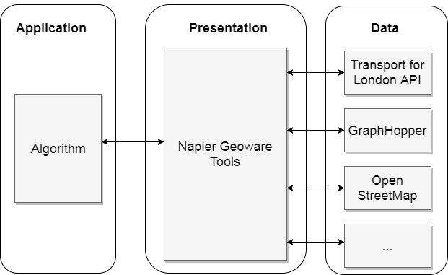
Architecture
If our interest is in problem solving then we only have to write the Application layer and understand the presentation layer.
If our application needs to access differing data sources it only requires minimal changes at the application level

Slide 9
Architecture
The presentation layer (NGT) is open source (hopefully others will add to it!)
The presentation layer provides an Interface based around a set of generic classes for routes, locations etc.
When objects are passed from the presentation to application layers the source of the data should be recorded.

Slide 10
Overview
In order to speed up various projects it was decided to implement the architecture as Napier Geoware Tools.
The initial set of tools would be constructed by a group of students as final year projects:
Jannik Enenkel
Jannik Geyer
Jan-Niklas Keiner
Johannes Nguyen
Jan Steulerand
All were exchange students from Technische Hochschule Mittelhessen

Slide 11
NGT – Contents
OSM Querying
GraphHopper routing
Transport for London routing
KML writer
Events/Diary API
Some utility classes for basic geospatial and OSM data operations

Slide 12
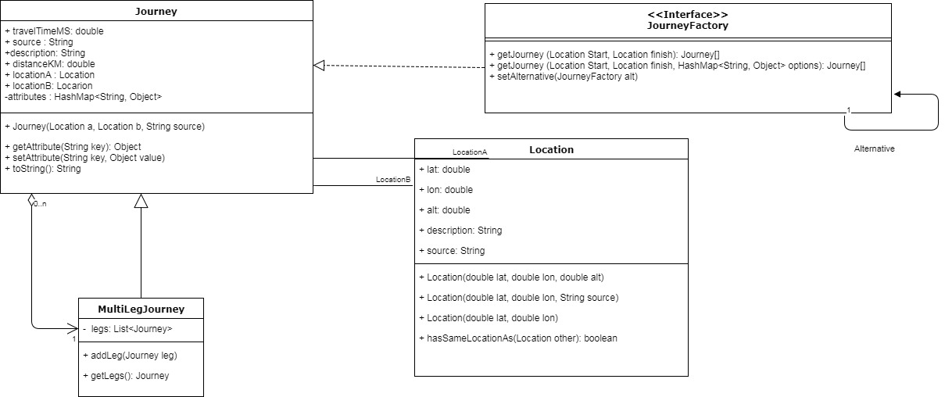
Detailed Design

Slide 13
Detailed Design
Useful features
Use of “Alternative” router
MultiLegJourney

Slide 14
Example
A contrived example (this is available online along with other examples)
From a location in Central London, find all of the pubs with 1 square mile
Order them in nearest neighbour order
Turn that order into a route using TfL journeys
Create a calendar with an appointment at each pub (times based on journey times)
Print out the instructions
Print out a map of the route

Slide 15
Example 1
Location currentLocation = new Location(51.507115,-0.127437);
OSMFileUtils.setOsmFilter("/usr/local/Cellar/osmfilter/0.7/bin/osmfilter ");
OSMFileUtils.extractData(currentLocation, "greater-london-latest.osm.pbf", "centralLondon.osm",true);
QueryOsmFacade facade = new QueryOsmFacade();
facade.parseOSMFile("centralLondon.osm");
//need to be able to get OSM data
System.out.println("Found: ");
ArrayList <Location> pubs= facade.findLocationsWithRegEx("pub", currentLocation);
for(Location l : pubs){
System.out.println(l);
}
EasyKMLCreator kml = new EasyKMLCreator();
kml.addPlacemarks(pubs);

Slide 16
Example
JourneyFactory router = new SimpleRouter(20);
ArrayList<Location> ordered = nearestNeighbour(currentLocation, pubs,router);
//Setup routers
router = new TransportForLondonFacade("You need to obtain a TfL API key for here....");
JourneyFactory gh = setupHopper();
router.setAlternative(gh);
gh.setAlternative(new SimpleRouter(20));
//Create journey
MultiLegJourney trip = new MultiLegJourney();
Location prev = currentLocation;
for (Location next : ordered){
Journey[] myJourney = router.getJourney(prev, next);
trip.addLeg(myJourney[0]);
prev = next;
}
kml.addJourney(trip);
Note the use of alternative JourneyFactories…. If the TfL API fails to return a route, then GraphHopper is tried, if that fails then SimpleRouter is tried as a last resort

Slide 17
Example
try{
kml.saveKMLDocument("london1.kml");
}catch(Exception e){
e.printStackTrace();
System.out.println("Error saving KML");
}
//Create a schedule of calendar events
DiaryFacade schedule = new DiaryFacade();
schedule.deleteAllEvents();//Remove any previous events loaded from file
try{
int count = 0;
LocalDateTime myTime = LocalDateTime.of(2017, 6, 8, 11, 00);
for (Journey j : trip.getLegs()){
String description = "Visit " + count;
if (count==0) description = "Start";
LocalDateTime leave = myTime.plusMinutes(15);
CalendarEntry ce = schedule.createCalendarEntry(myTime, leave, description, j.getPointA().getDescription(), j.getPointA(), null);
j.putAttribute(Journey.FROM_CALENDAR_ENTRY, ce);
int s = (int)j.getTravelTimeMS()/1000;
myTime = leave.plusSeconds(s);
count++;
}
}catch(Exception e){
System.out.println(e);
}

Slide 18
Example
try{
kml.saveKMLDocument("london1.kml");
}catch(Exception e){
e.printStackTrace();
System.out.println("Error saving KML");
}

Slide 19
Example
//Create a schedule of calendar events
DiaryFacade schedule = new DiaryFacade();
schedule.deleteAllEvents();//Remove any previous events loaded from file
try{
int count = 0;
LocalDateTime myTime = LocalDateTime.of(2017, 6, 8, 11, 00);
for (Journey j : trip.getLegs()){
String description = "Visit " + count;
if (count==0) description = "Start";
LocalDateTime leave = myTime.plusMinutes(15);
CalendarEntry ce = schedule.createCalendarEntry(myTime, leave, description, j.getPointA().getDescription(), j.getPointA(), null);
j.putAttribute(Journey.FROM_CALENDAR_ENTRY, ce);
int s = (int)j.getTravelTimeMS()/1000;
myTime = leave.plusSeconds(s);
count++;
}
}catch(Exception e){
System.out.println(e);
}

Slide 20
Example
System.out.println("My Trip \n" );
schedule.printAllCalendarEntries();
//Show directions
for (Journey j : trip.getLegs()){
System.out.println("Appointment " + j.getAttribute(Journey.FROM_CALENDAR_ENTRY));
System.out.println("Journey: From " + j.getPointA().getDescription());
System.out.println("To " + j.getPointB().getDescription());
System.out.println("Instructions : " + j.getAttribute(Journey.INSTRUCTIONS));
System.out.println("Journey data source : " + j.getSource());
}

Slide 21
Get involved
https://github.com/NeilUrquhart/NapierGeowareTools
Use it…. Contribute to it…..
Give some feedback
More documentation to follow
Feel free to contact n.Urquhart@napier.ac.uk for support

Slide 22
Future Work
More JourneyFactory classes for useful APIs
Possibly integrate with a Javascript library such as Leaflet
Much depends on
What I need to support my own research
A supply of students (and others) who are willing to add to the library

